Slide 1



LIC OF INDIA
DIGITAL MARKETING PROJECT WORK
Presented by
Alivelu (TL)
Pushpa
Sreya
Rambabu

Slide 2

Intro
Project Overview
Life insurance policy
A life insurance policy is a contract between an individual and an insurance company where the insured pays regular premiums in exchange for a lump-sum payment, known as a death benefit, to be provided to the designated beneficiaries upon the insured's death. It's a financial tool designed to provide financial security and support to the insured's loved ones after they pass away.

Slide 3
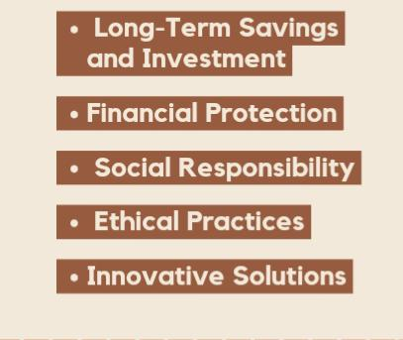
Smart goals of LIC
Long-Term Savings and Investment
Financial Protection
Social Responsibility
Ethical Practices
Innovative Solutions

Slide 4
Key performance indicators of LIC
01
Premium growth rate
06
Claim rejection rate
01
06
02
Policy persistency rate
02
05
Product mix and penetration
05
03
04
04
Solvency rate
03
Claim settlement ratio

Slide 5
USP of LIC in india
(Unique seller point)
LIC thus concentrates on as a unique selling proposition. Unlike private players, the company claims it has fewer delinquencies, lapsed policies and discontinuance of high premium policies, a claim that many contest.
Mass volumes

Slide 6
25
20
AUDIENCE PERSONA
15
10
5
0
Bheema jyothi
Bachath plus
Jeevan laabh
Bheema bachath
Jeevan lakshya

Slide 7
Competitive analysis
HDFC SWOT Analysis
Strengths
Weakness
Opportunities
Threats
Diverse product portfolio
Strong brand reputation
Premium costs and
Policy complexity
Market expansion and
Digital transformation
Market competition and cybersecurity risks
Add a main point

Slide 8
Competitive analysis
Kotak SWOT Analysis
Strengths
Weakness
Opportunities
Threats
Customer centric approach
Sustainable practices
Limited online features
Dependent on agents
Partnership and alliance
and
Global expansion
Technology disruptions
and
investment risks

Slide 9

SEO and keyword research
life insurance
Best life insurance companies
Protective life insurance
Term life insurance
Best term life insurance

Slide 10
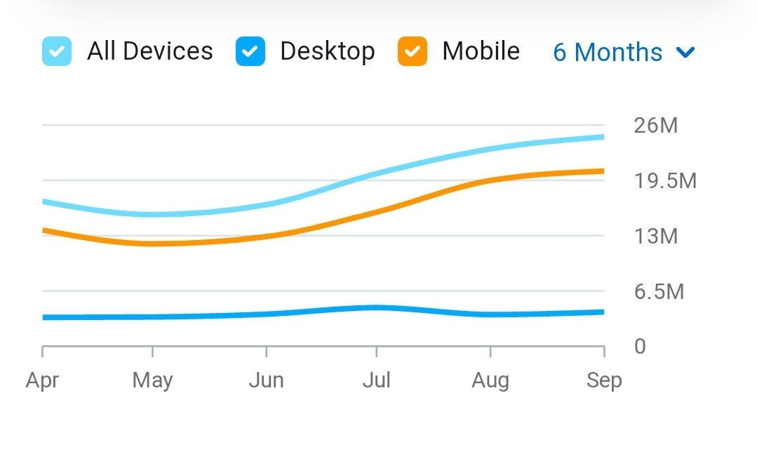

On page optimization of LIC

Slide 11

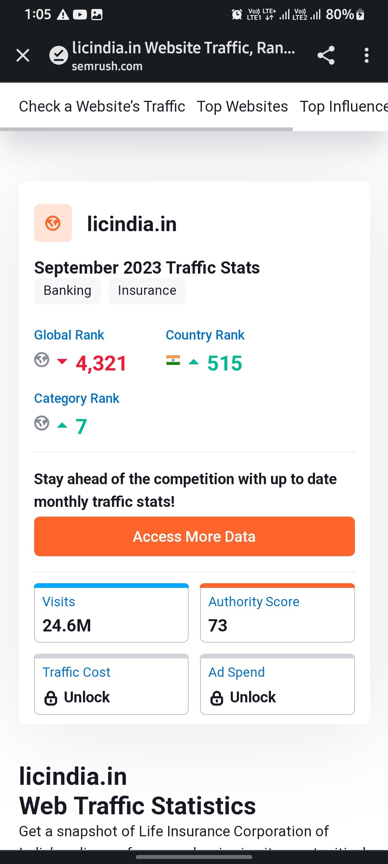
WEBSITE ANALYSIS

Slide 12
Marketing plan
For monthly performance
Week-1 | Week-2 | Week-3 | Week-4 | Last 2 days
Brand study,brand identity and competitive analysis. | Keyword research, Buyer's audience persona and content ideas generation. | SEO audit,on page optimization and marketing strategies. | Designing and editing videos, content creation and curation. | Post creation and social media campaigns.

Slide 13
Instagram stories and reels
Content format
Using animations to highlight content
Upload with transitions and editing

Slide 14
Content creation and designing videos
https://www.instagram.com/s/aGlnaGxpZ2h0OjE3OTc2MTc2MTQ0MzQ5NjIx?story_media_id=3212100458022248000_51963206015&igshid=MzRlODBiNWFlZA==
Instagram stories/
HHighlighs
https://www.instagram.com/s/aGlnaGxpZ2h0OjE3OTYxODMxNjkyNTE0OTUy?story_media_id=3212357339512881970_51963206015&igshid=MzRlODBiNWFlZA==

Slide 15
Content creation and designing videos
https://www.instagram.com/reel/CyTpx7AyKjy/?igshid=MzRlODBiNWFlZA==
Instagram reels
https://www.instagram.com/reel/CyUjypaSTUF/?igshid=MzRlODBiNWFlZA==

Slide 16
TEAM MEMBERS AND ROLES
K.Alivelu (Team lead)- SEO and keyword research, on page optimization, marketing strategies and post creation.
B.Sreya- Video creation and editing, social media campaigns,content creation and curation.
R.Gowri pushpa- Information gathering about Brand identity and buyer's persona.
B.Rambabu- Collected information on Competitive analysis and brand study.

Slide 17
THANK YOU
Short term internship final project

